Slide 1
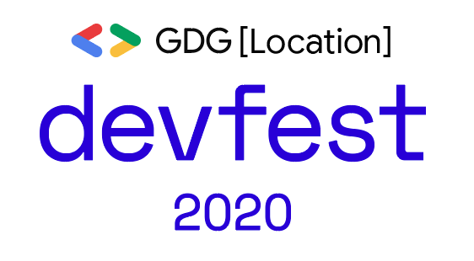
From TensorFlow 2 Object Detection to OpenVINO
刘 波
机器学习工程师, Intel China

Slide 2
TF2 OD API

Slide 3
TF2
Eager execution
Higher-level APIs
Distribution strategies

Slide 4
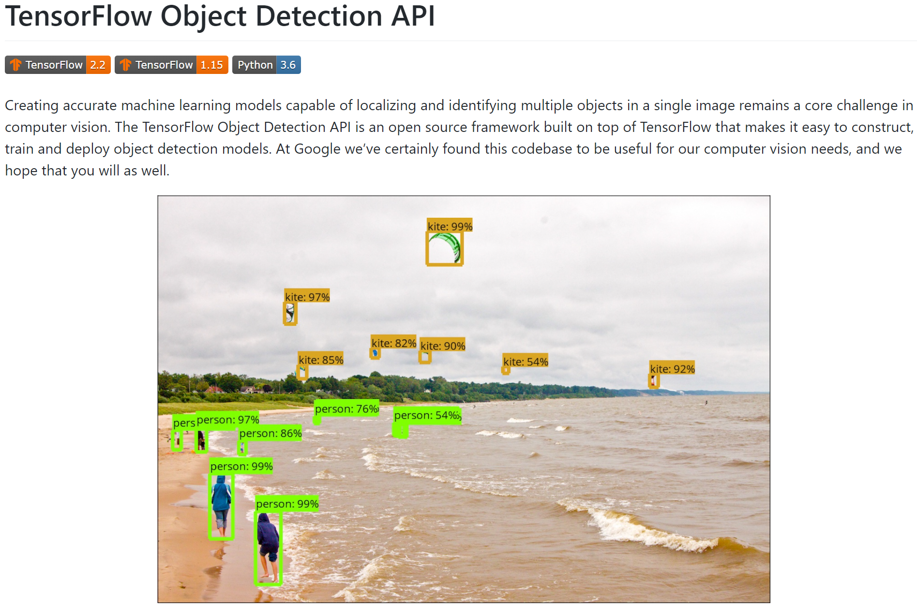
https://github.com/tensorflow/models/tree/master/research/object_detection

Slide 5
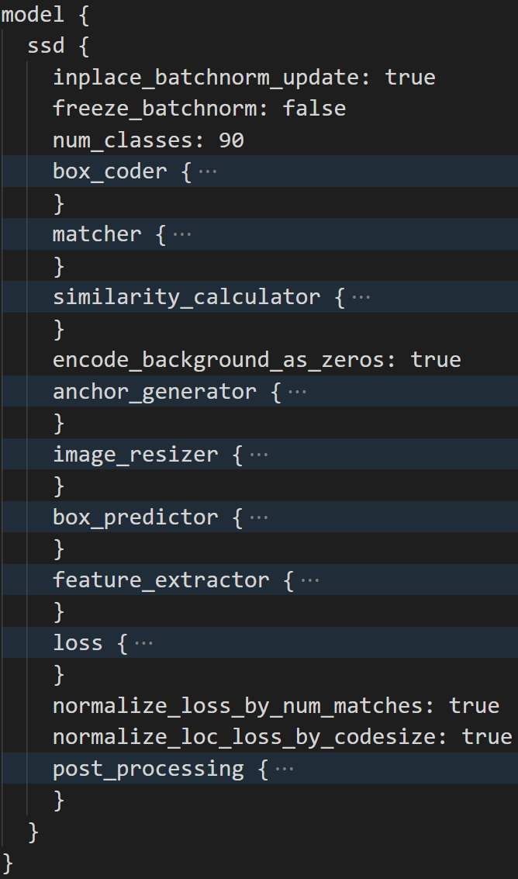
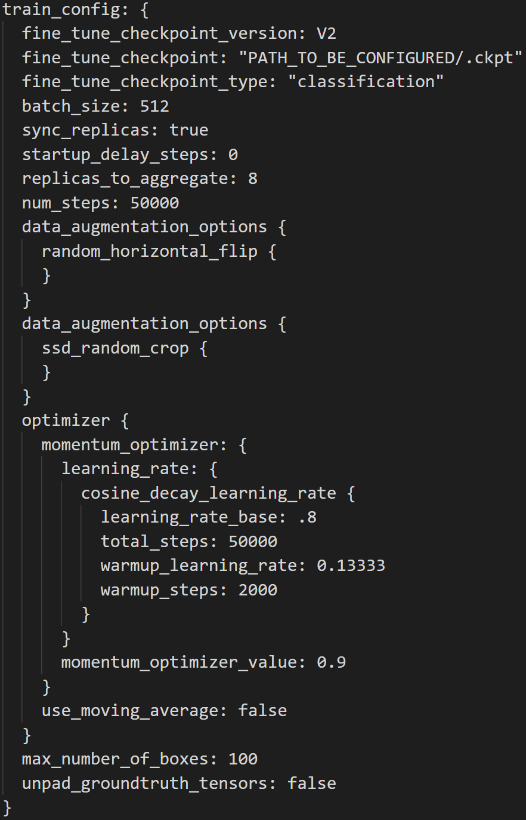
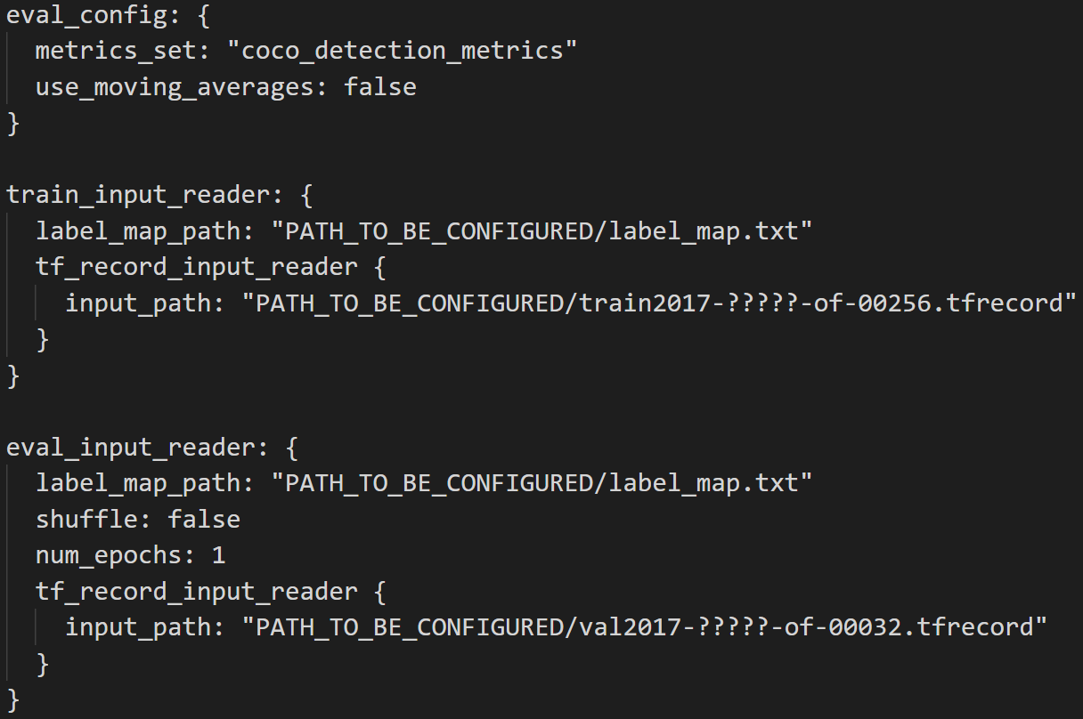
TF2 OD API Training Pipeline
Model configuration
Train_config
Eval_config
Train_input_config
Eval_input_config

Slide 6
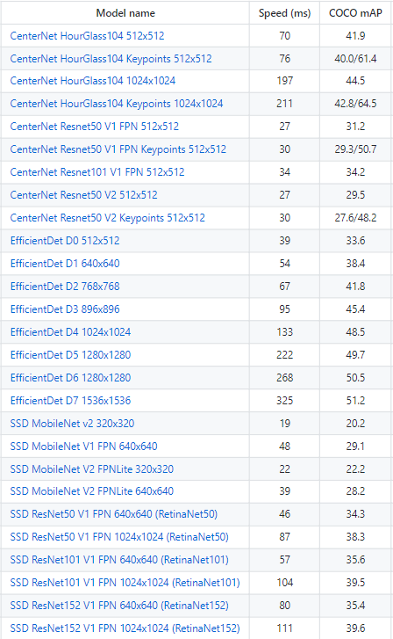
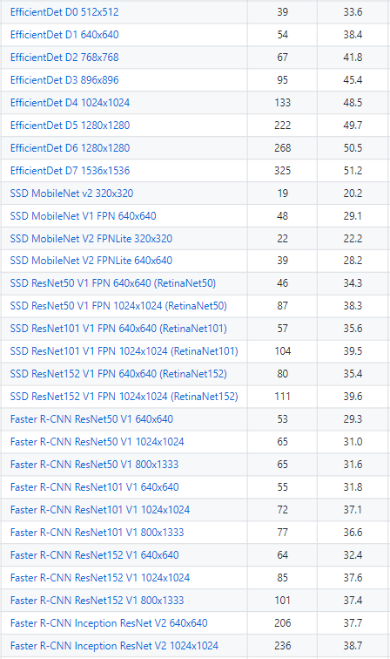
TF2 OD API Models
Eager model compatible
New Archs (EfficientDet...)
COCO pre-trained weights
No changes to pipeline conf.
Unified CV lib (soon)
https://blog.tensorflow.org/2020/07/tensorflow-2-meets-object-detection-api.html
https://github.com/tensorflow/models/blob/master/research/object_detection/g3doc/tf2_detection_zoo.md

Slide 7
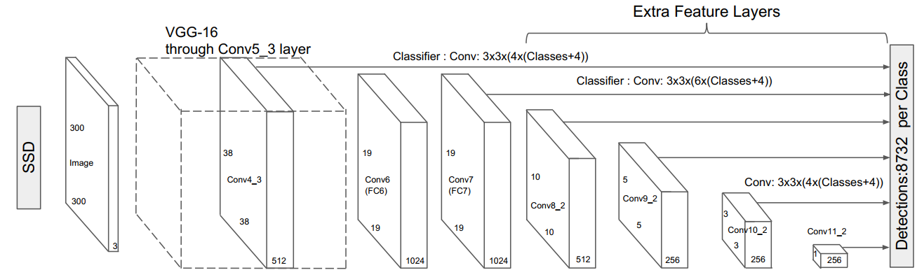
SSD as an example
SSD: Single Shot MultiBox Detector
Loc. offset
DetectionOutput (Non-Max Suppression)
image_id
lable
conf.
xmin
ymin
xmax
ymax
Conf.
PriorBox
PriorBox
# of Boxes

Slide 8
OpenVINO

Slide 9
Intel® Distribution of OpenVINO™ toolkit
High-Performance,
Deep Learning Inference
Streamlined Development,
Ease of Use
Write Once,
Deploy Anywhere
Faster, more accurate real-world results using high-performance, AI and computer vision inference deployed into production from edge to cloud.

Slide 10



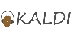



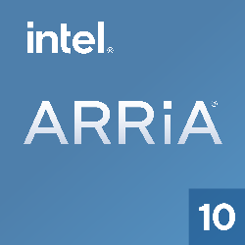
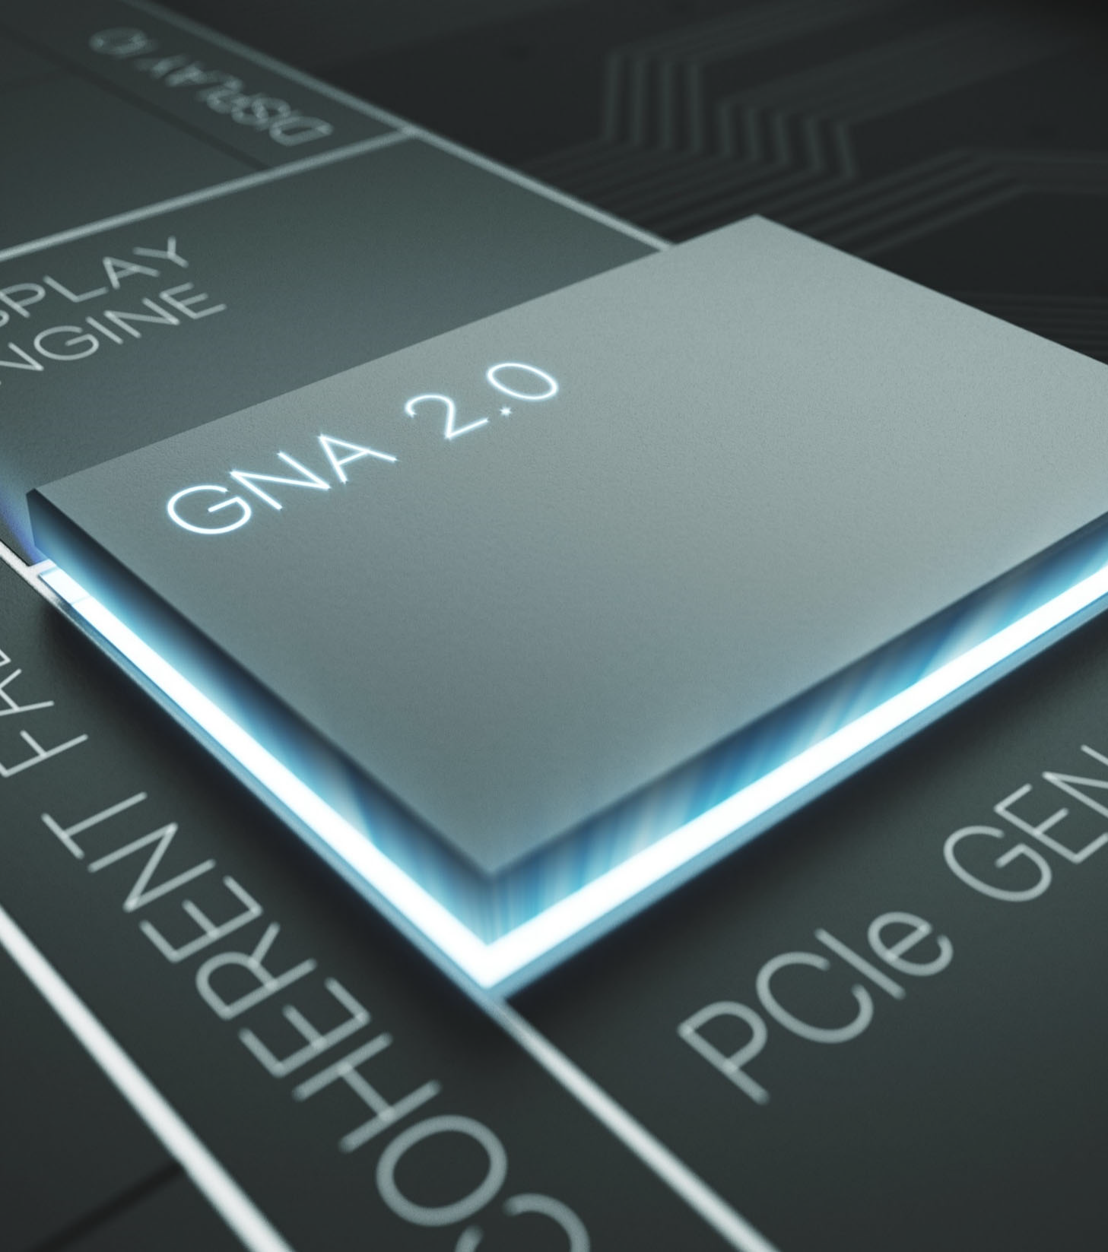
Typical workflow from development to deployment
1. BUILD
2. OPTIMIZE
3. DEPLOY
Support for TensorFlow 2.x
Support for Tiger Lake (11th Intel® Core® Processors)
Train a model
Run the Model Optimizer
Intermediate Representation
Deploy using the Inference Engine
Find a trained model
.bin, .xml
OpenVINO Model Server
Open Model Zoo
(200+ vision / non-vision models)
Deep Learning Workbench
Deep Learning Streamer
Post-training Optimization Tool
OpenCV
OpenCL
Computer Vision Annotation Tool
Neural Network Compression Framework
Code Samples & Demos
Benchmark App
Accuracy Checker

Slide 11
Model Optimizer is a cross-platform command-line tool that performs static model analysis, adjusts models for optimal execution on target devices and generates intermediate representation in .xml and .bin format.

Slide 12
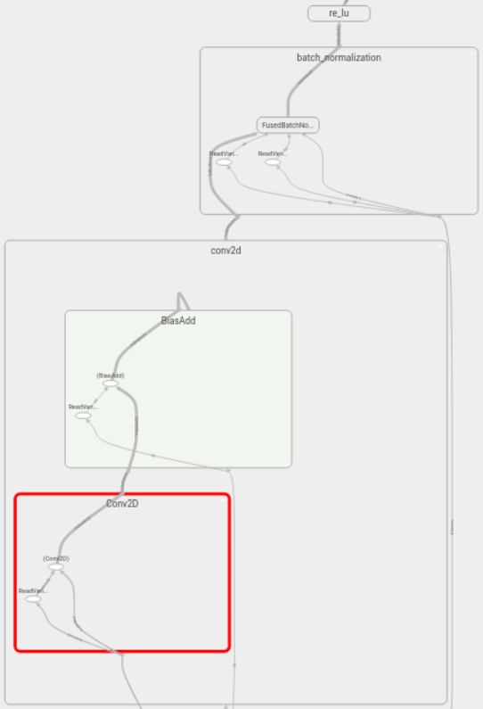
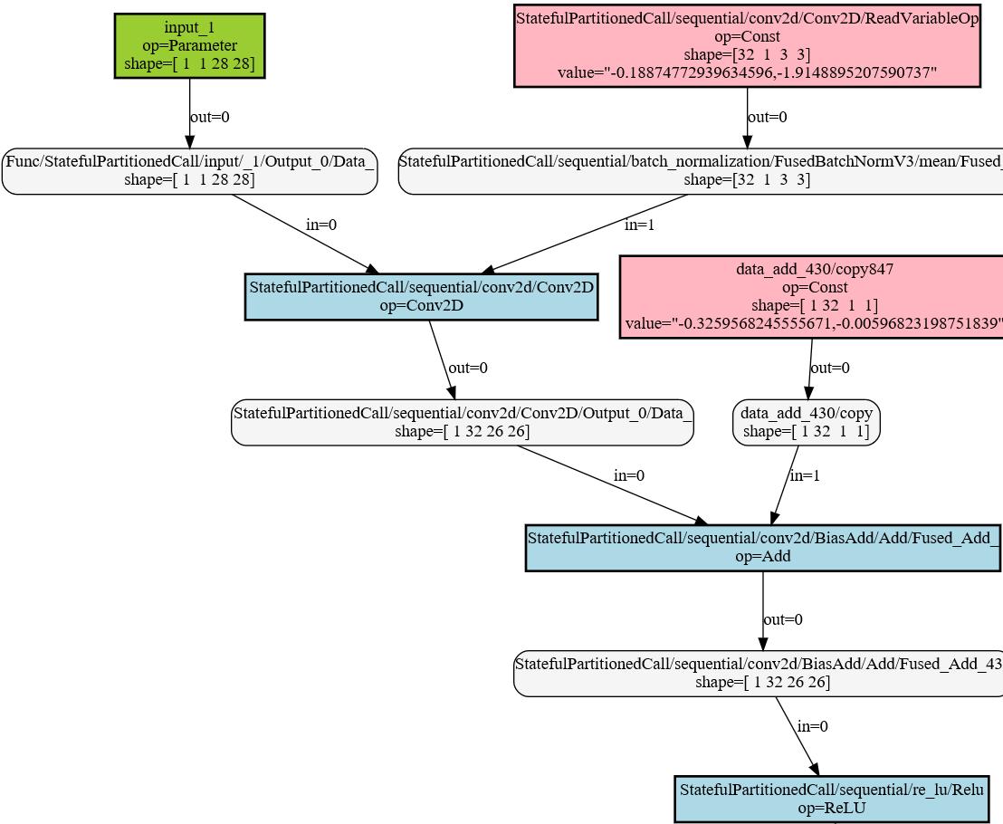
Model Optimizer: Basic conversion
TF2 w/ tensorboard
OpenVINO w/ graphviz
Subgraph: conv+bn+relu

Slide 13
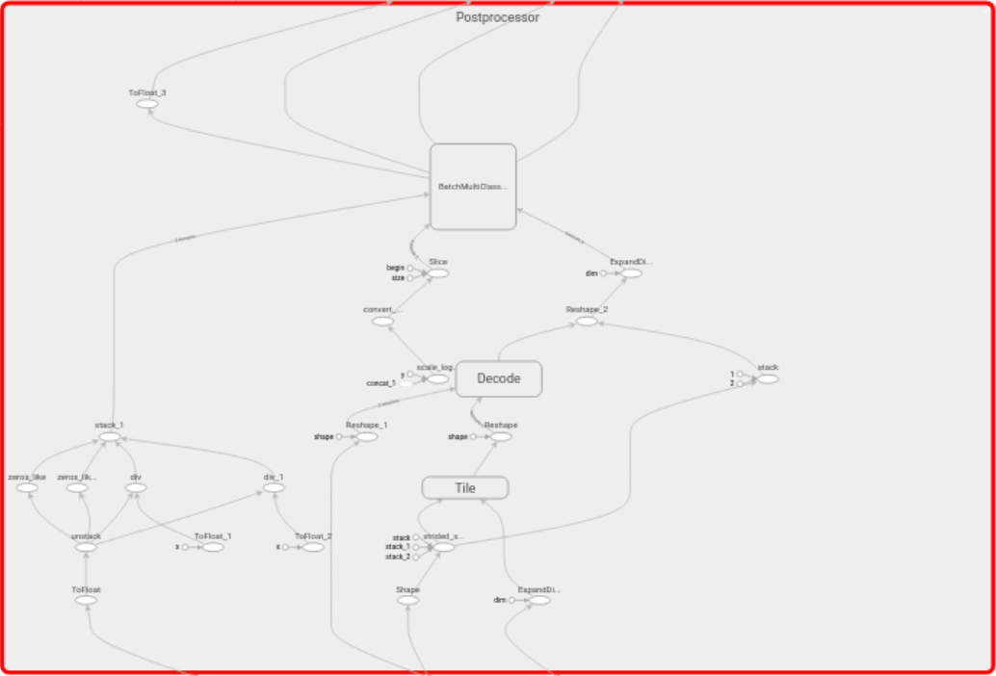
Model Optimizer: Sub-graph replacement
1. Identify target sub-graph
2. Generate new sub-graph
3. Connect new sub-graph
4. Remove old sub-graph
Replace a single op w/ a sub-graph
Replace a sub-graph w/ a new sub-graph
SquaredDifference
(a - b)²
Power
1 * (a - b)² + 0
Start Points
Scope
Add
a + (- b)
tensor a
tensor b
End Points
tensor a
Power
-1 * b¹ + 0
Match 1
Nodes/Edges
Match 2
Scope
Match 3
Points
tensor b
Implement new sub-graph

Slide 14
Inference Engine is a set of C++ libraries providing a common API to deliver inference solutions on the platform of your choice: CPU, GPU, or VPU. C libraries and Python bindings are also available.

Slide 15
Inference Engine: Stack
Applications
Inference Engine runtime
Inference Engine (Common API)
Multi-device plugin (optional but recommended - for full system utilization)
mkl-dnn plugin
clDNN plugin
GNA plugin
Myriad & HDDL plugins
FPGA plugin
Plugin architecture
Intrinsics
OpenCL™
GNA API
Movidius API
DLA

Slide 16
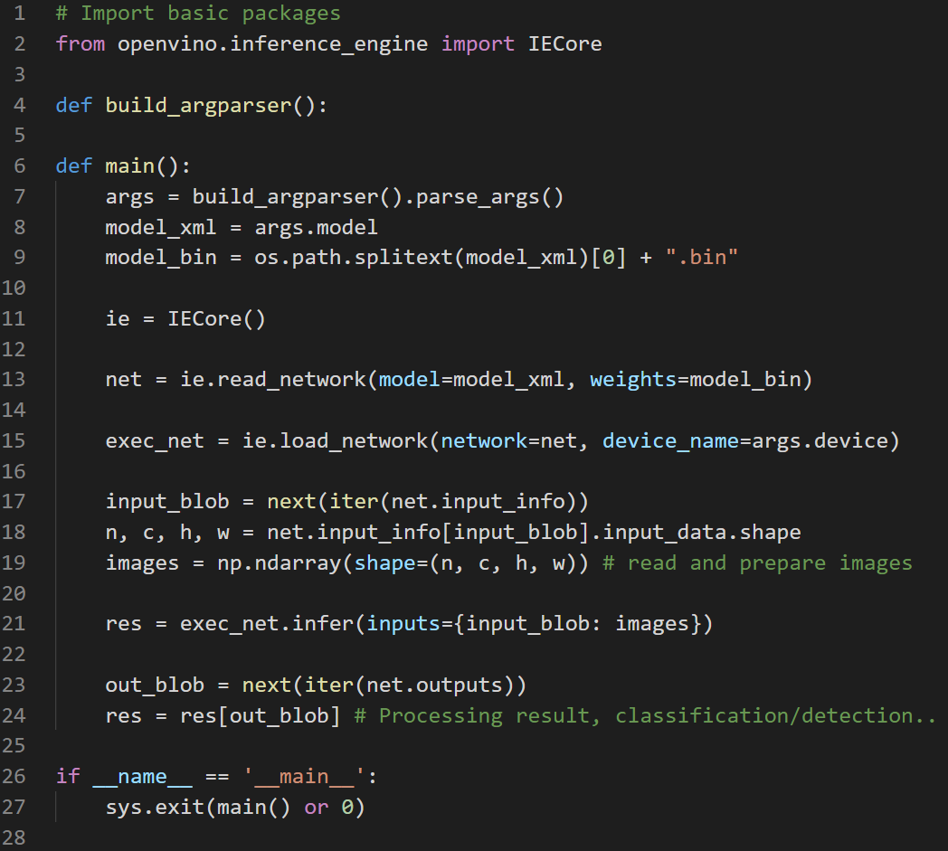
Inference Engine: APIs
Create Inference Engine
Read network model
Load model to plugin
Prepare input data
Run the inference
Get the output

Slide 17
Perf.-Oriented: Async API
Synchronous: blocks until inference is completed.
Asynchronous: checks the execution status with the wait, or specifies a completion callback.
Sync API
Transfer 1
Transfer 2
Inference 1
Inference 2
Time
Async API
Transfer 1
Transfer 2
Inference 1
Inference 2

Slide 18
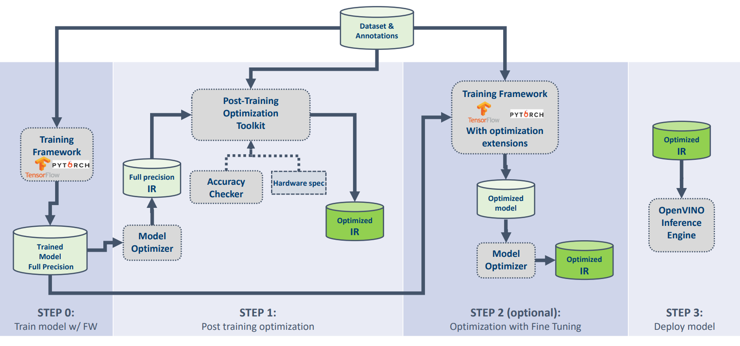
Perf.-Oriented: Low Precision (e.g. INT8)
https://docs.openvinotoolkit.org/latest/openvino_docs_performance_int8_vs_fp32.html
Low
Precision
Runtime
and
Hardware
Quantization-Aware Training with
Neural Network
Compression Framework
Do NOT Need Model Re-Training

Slide 19
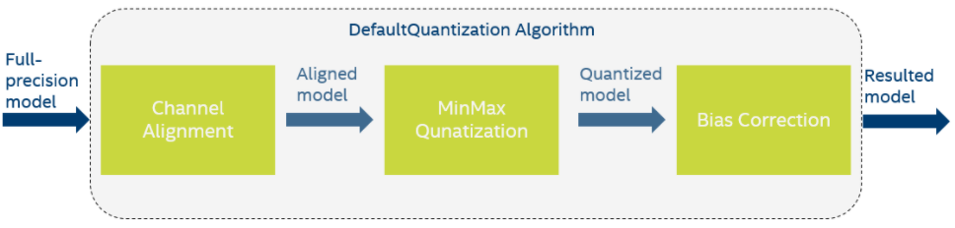
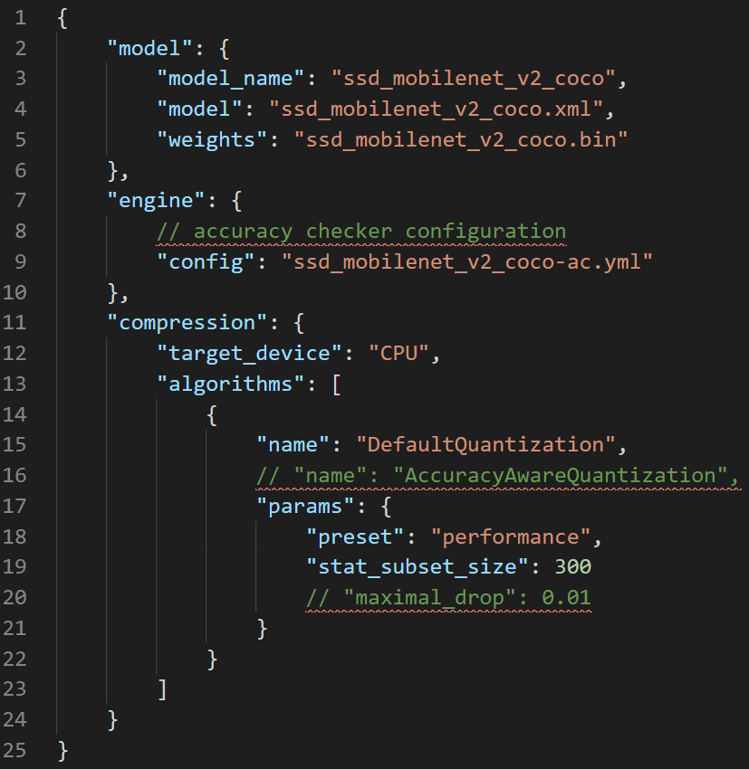
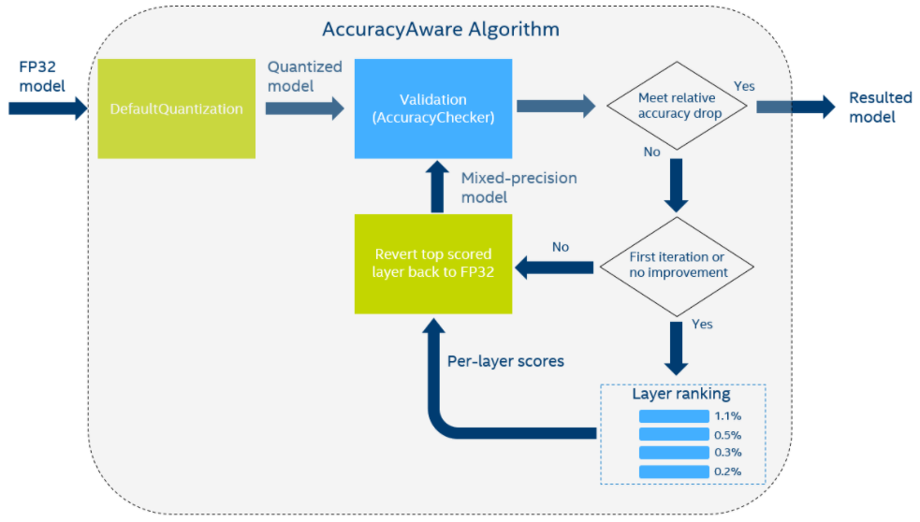
Perf.-Oriented: Post-Training Optimization Tool
$pot –c <path-to-configuratuin.json>

Slide 20
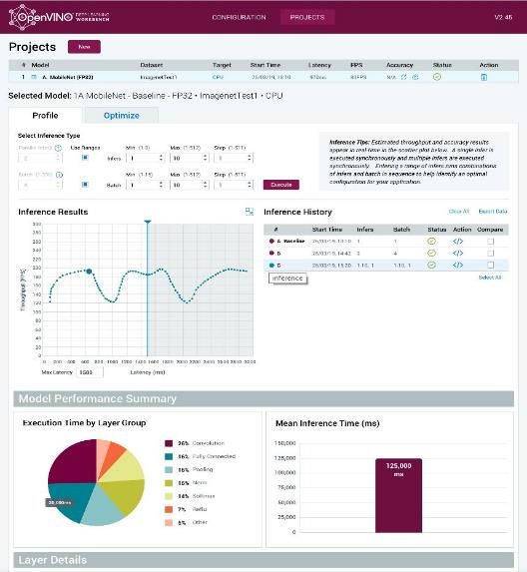
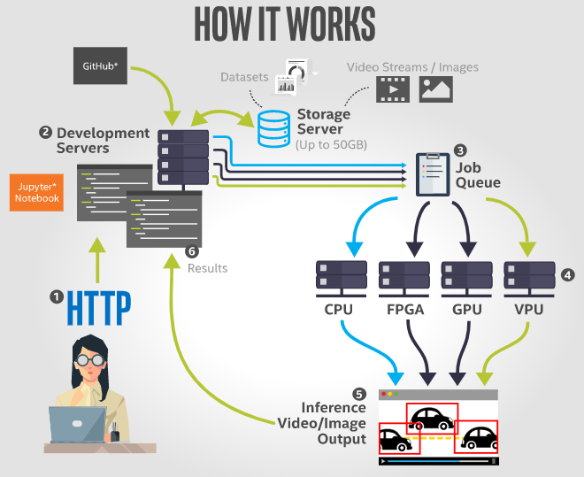
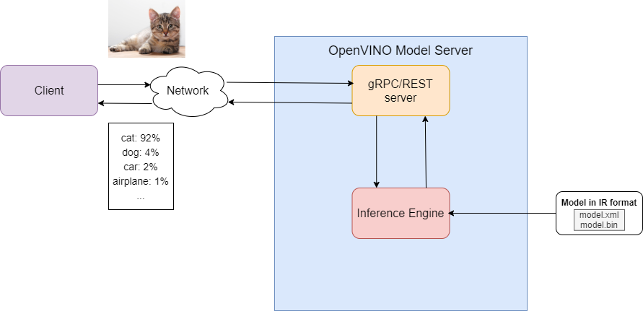


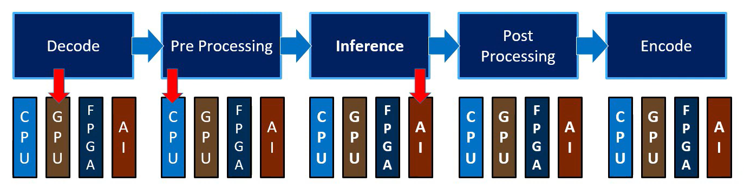
Other OpenVINO Components
DL Workbench
Edge
DevCloud
DL
Streamer
Model
Server

Slide 21
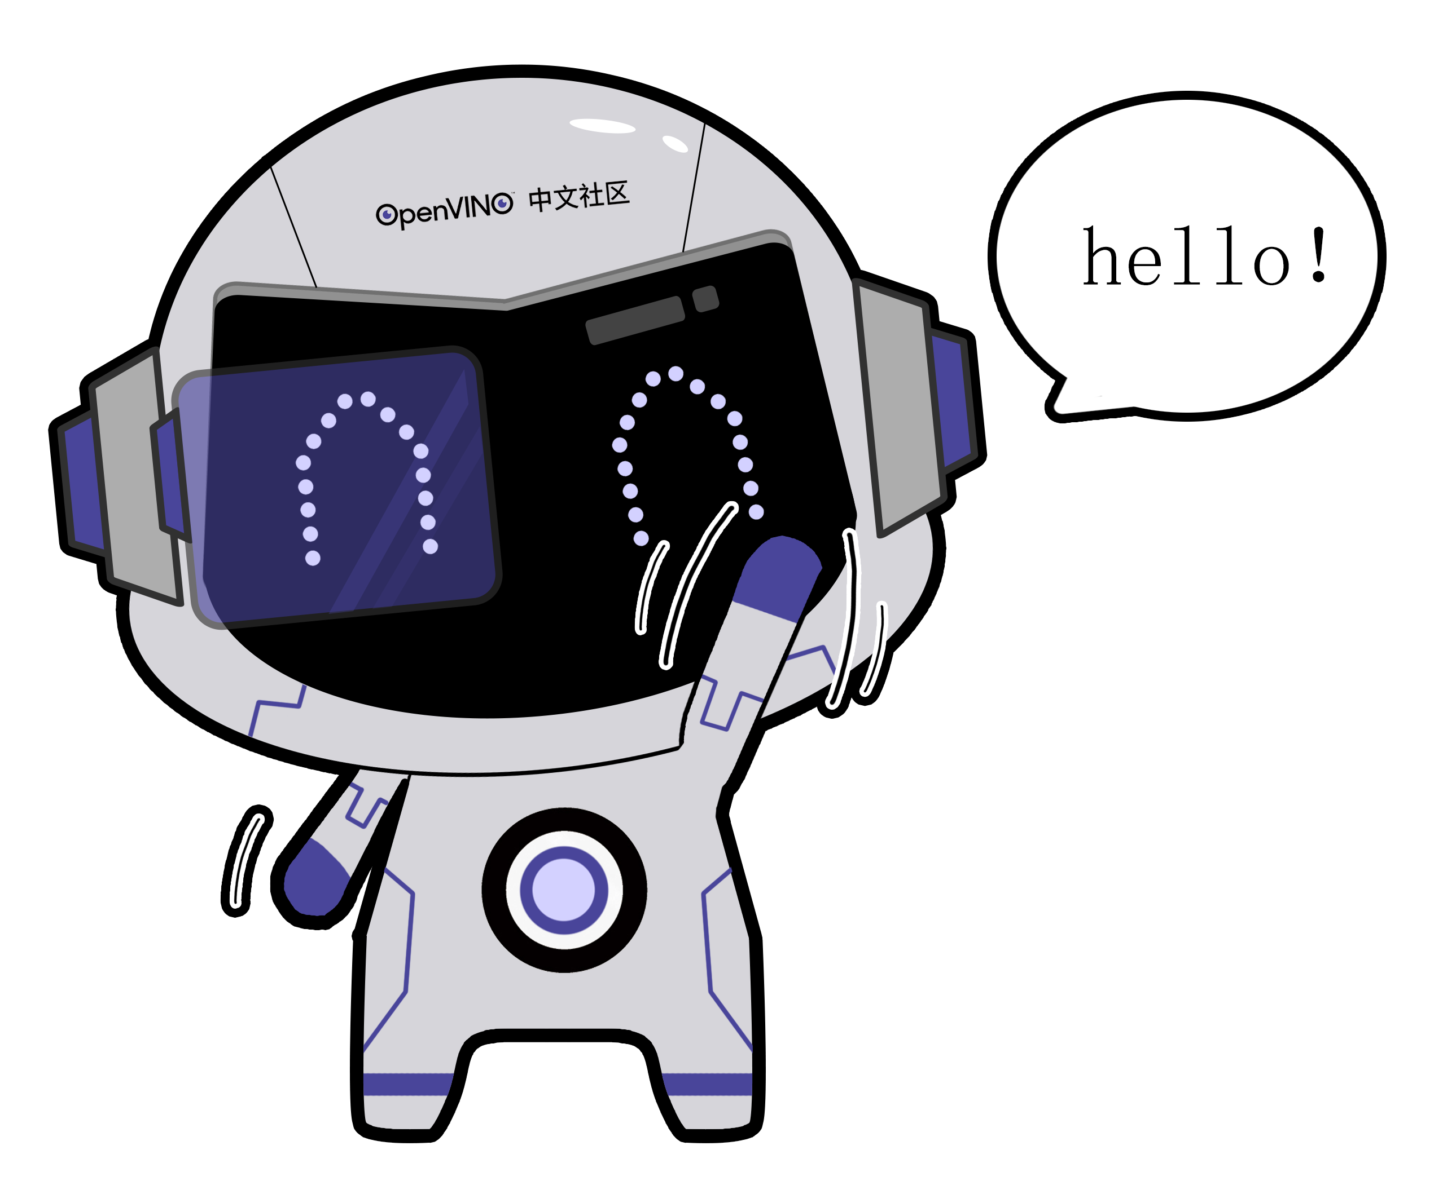

OpenVINO Resources
Official Docs
Official GitHub / Gitee
OpenVINO Chinese Community

Slide 22
Codelab

Slide 23
现场任务
在 TF2 中训练 MNIST 模型并使用 OpenVINO 完成本地运行
使用 OpenVINO 转换 TF2 OD API 中的 SSD 预训练模型并完成本地部署和优化 （给定 coco 验证集 100 张图，在正确推理的基础上逐步提升性能，可使用 batch、异步 Async API等，可尝试跨平台加速）
对有兴趣贡献社区的开发者，可共同参与 OpenVINO 转换 TF2 OD 全模型挑战 （持续…）
本场活动参考链接：
https://github.com/brianliu3650/2020-BJ-GDG-DevFest-TF2-OpenVINO-Codelab

